Slide 1

Vel Tech Rangarajan Dr. Sagunthala R&D Institute of Science and Technology
School of Computing
Department of Computer Science and Engineering
10211CS224 / FULL STACK APPLICATION DEVELOPMENT (JAVA)
END SEMESTER PROJECT REVIEW
Date: 06-05-2026
ONLINE TICKET BOOKING SYSTEMFOR COLLEGE EVENTS
SDG 9: Industry, Innovation and Infrastructure
Presented By:
N.Karthik – VTU26057 – Reg.No.23UECS0385
Courses Handling Faculty:
Dr. Hafizur Rahman -Assistant Professor

Slide 2
INTRODUCTION
1
Manual ticket booking for college events is often time-consuming, error-prone, and difficult to manage efficiently.
Students may face issues like long queues, limited availability of information, and lack of transparency.
This project is important as it digitizes the entire ticket booking process, making it faster and more reliable.
It reduces manual effort and minimizes errors in ticket allocation and record management.
In real-world scenarios, such systems are widely used in events, cinemas, and transportation services.
Implementing this in a college environment improves accessibility and participation in events.
The system provides an online platform where users can browse events, book tickets, and make payments easily.
It also includes an admin module to manage events, monitor bookings, and maintain records efficiently.
2
3
4
5
6
7
8
9

Slide 3
PROBLEM STATEMENT
1
In many colleges, event ticket booking is still handled manually or through unorganized methods.a
This leads to long queues, delays, and difficulty in managing large numbers of participants.
Manual systems are prone to errors such as duplicate entries, ticket loss, and inaccurate records.
Students often lack clear information about event availability and booking status.
There is no centralized platform to manage bookings, payments, and event details efficiently.
This reduces overall participation and creates inconvenience for both students and organizers.
Therefore, there is a need for a simple, secure, and automated ticket booking system.
Such a system will improve accuracy, save time, and ensure smooth event management.
2
3
4
5
6
7
8
9

Slide 4
OBJECTIVE(S)
To develop a web-based system for online ticket booking:
The objective is to design and implement an interactive web application that enables students to easily browse upcoming college events, view event details, and book tickets anytime from anywhere. This system will provide a seamless user experience with simple navigation, reducing the need for physical presence and long queues.
To create an efficient admin module for management:
The project aims to include a dedicated admin interface that allows organizers to create and update events, manage ticket availability, monitor bookings in real time, and maintain accurate records. This helps in better coordination, reduces manual errors, and ensures smooth handling of large-scale events.
To ensure a secure, fast, and user-friendly platform:
Another key objective is to build a system that is reliable and secure, protecting user data and transaction details. The platform will be optimized for speed and usability, making it accessible to all users while minimizing manual effort and improving overall efficiency in event management.
1
2
3
4
5
6
7
8
9

Slide 5
PROPOSED SYSTEM
The proposed system is a web-based online ticket booking platform designed specifically for college events.
It provides a centralized portal where students can view event details, check availability, and book tickets instantly.
The system eliminates manual processes, thereby reducing long queues and saving time for both students and organizers.
It ensures accurate data management by maintaining digital records of bookings, avoiding duplication and errors.
An integrated admin module allows organizers to efficiently manage events, monitor ticket sales, and update information in real time.
The system improves transparency by providing real-time booking status and confirmations to users.
Compared to traditional methods, it offers greater convenience, accessibility, and reliability through automation.
Overall, it enhances user experience and ensures smooth, fast, and organized event management.
1
2
3
4
5
6
7
8
9

Slide 6
PROPOSED SYSTEM ARCHITECTURE
Input
The input includes user details such as login credentials, event selection, number of tickets, and payment information.
Admin input includes event creation details like event name, date, venue, and ticket limit.
Processing
The system processes user requests by validating login details, checking ticket availability, and handling booking operations.
It also processes payments, updates ticket counts, and ensures proper communication between user and admin modules.
Database
The database stores all important information such as user data, event details, booking records, and transaction history.
It ensures secure storage and quick retrieval of data whenever required.
Output
The output includes booking confirmation, ticket details, and payment status displayed to the user.
Admin receives reports such as total bookings, event status, and user participation details.
1
2
3
4
5
6
7
8
9

Slide 7
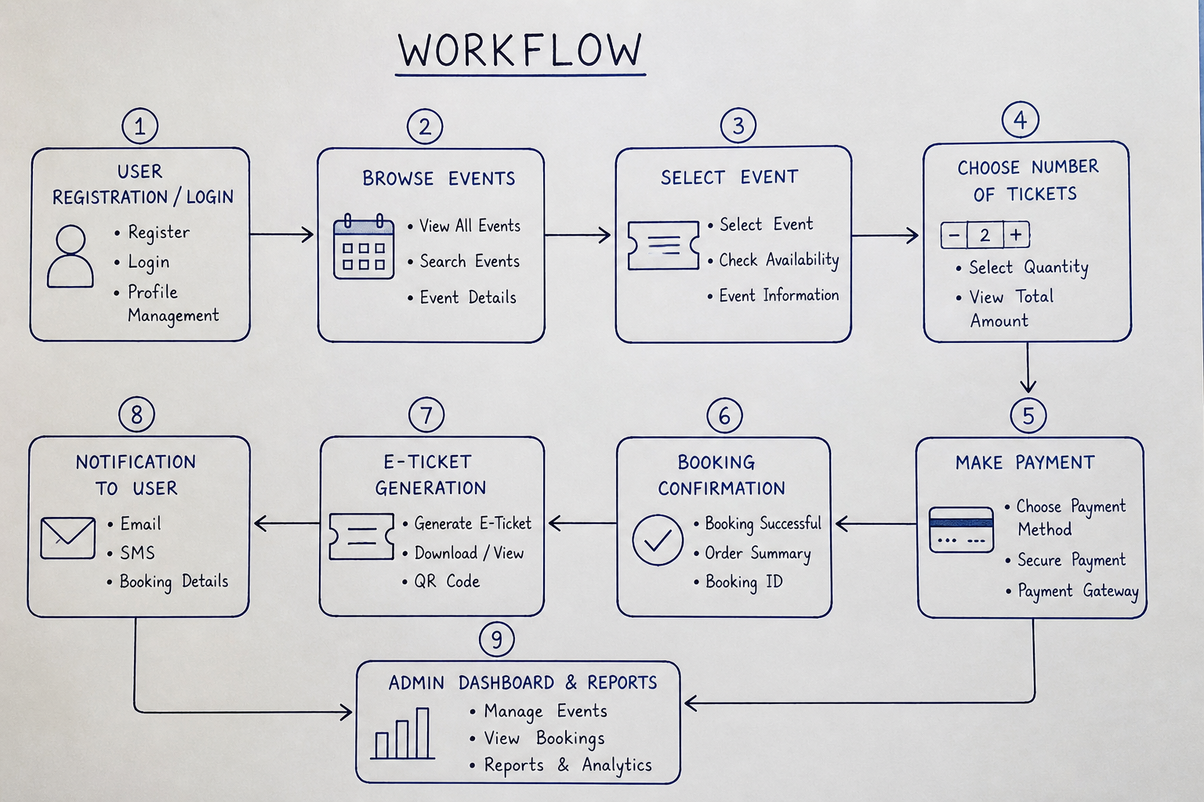
WORKFLOW
1
2
3
4
5
6
7
8
9

Slide 8
TECHNOLOGIES USED
> Frontend:
- HTML
- CSS
- JavaScript
- React.js
> Backend:
- Node.js
- Express.js
> Database:
- MongoDB
> Third-Party APIs:
- Razorpay (Payment Gateway)
- Email/SMS API (Notifications)
> Tools:
- VS Code
- Git & GitHub
- Postman
- Chrome Browser
> Platform:
- Web Application (Cross-platform)
> Operating System:
- Windows / Linux / macOS
1
2
3
4
5
6
7
8
9

Slide 9
MODULE DESCRIPTION
Module 1: User Management
Handles user registration, login, and profile management with secure authentication.
Allows users to create accounts, log in, and view booking history.
Module 2: Event & Ticket Management (Core Processing)
Manages event creation, event listing, and ticket booking process.
Processes user inputs such as selecting events and booking tickets efficiently.
Module 3: Database Management
Stores and manages user data, event details, booking records, and payment information.
Ensures data integrity, consistency, and quick retrieval.
Module 4: Payment & Notification Module (Innovative Module)
Integrates secure payment gateways for online transactions.
Provides features like e-ticket generation and email/SMS notifications.
Module 5: Reporting & Analytics
Generates reports such as total bookings, revenue, and participant details.
Helps in analyzing data for better event management decisions.
1
2
3
4
5
6
7
8
9

Slide 10
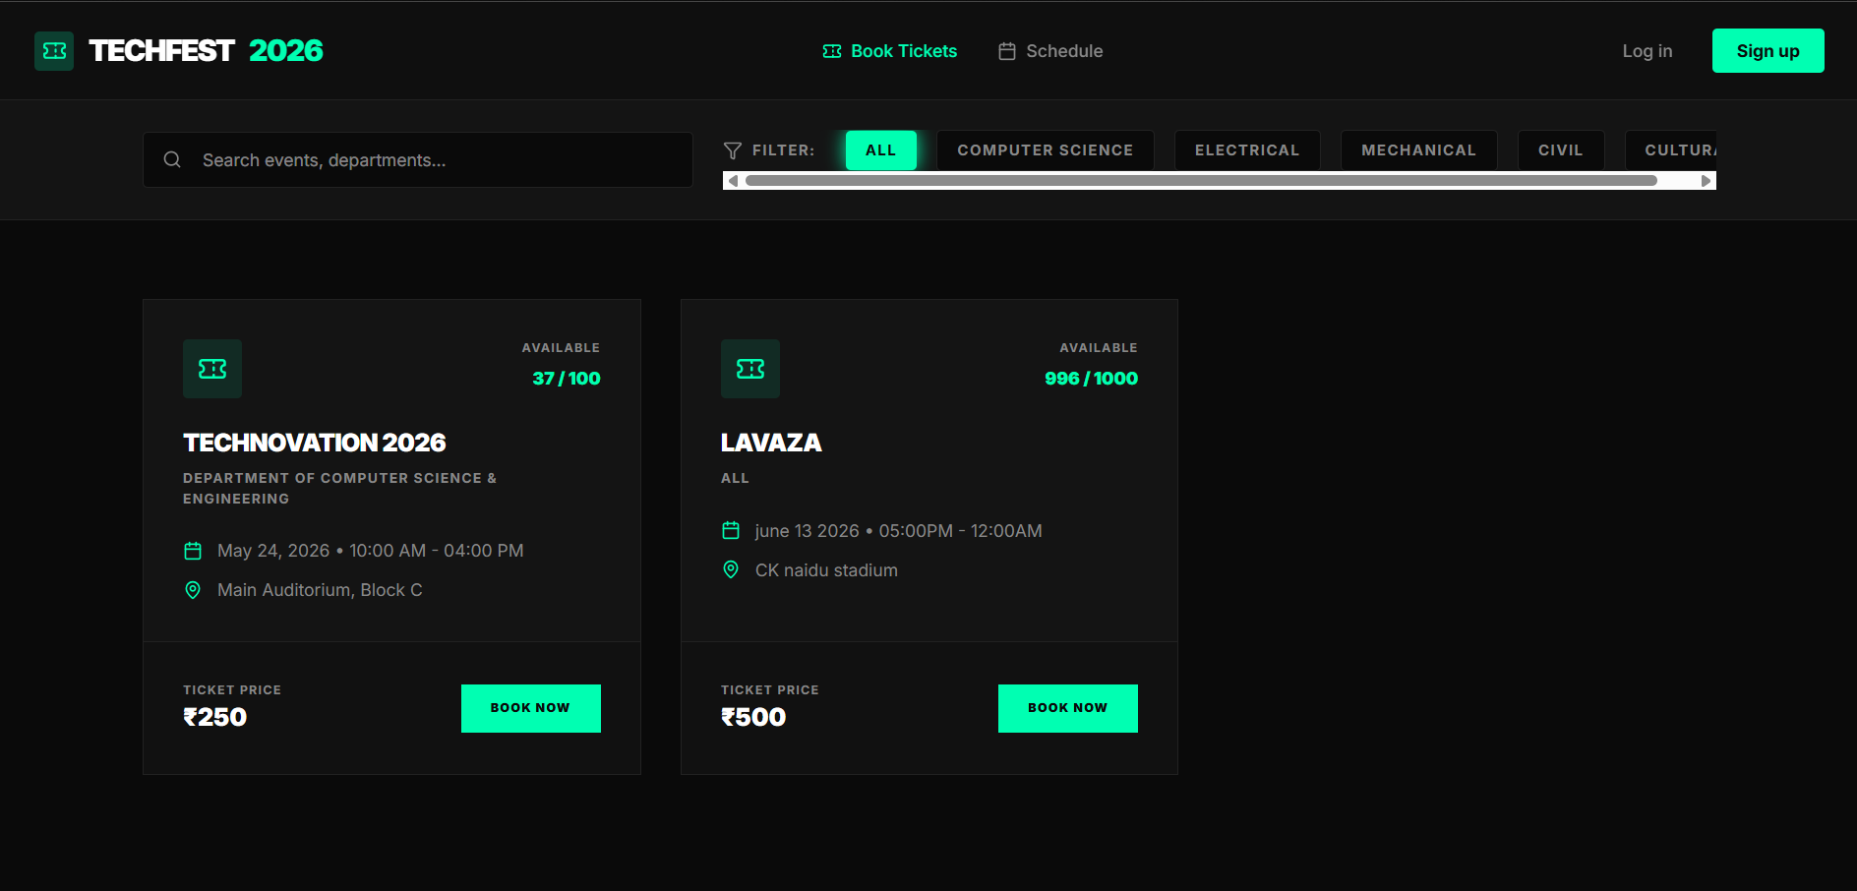
IMPLEMENTATION SCREENSHOTS
1
2
3
4
5
6
7
8(A)
This page displays a user-friendly event listing interface where users can search, filter, and browse available college events with details like date, venue, and ticket availability.
It also allows users to quickly view ticket prices and book tickets online through a simple and interactive “Book Now” option.
9

Slide 11
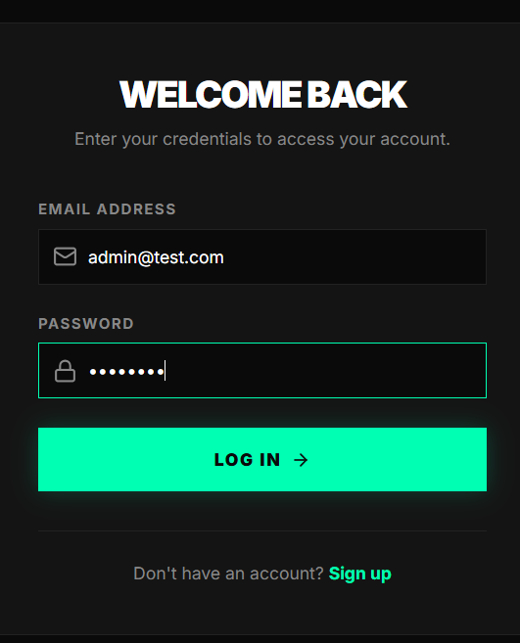
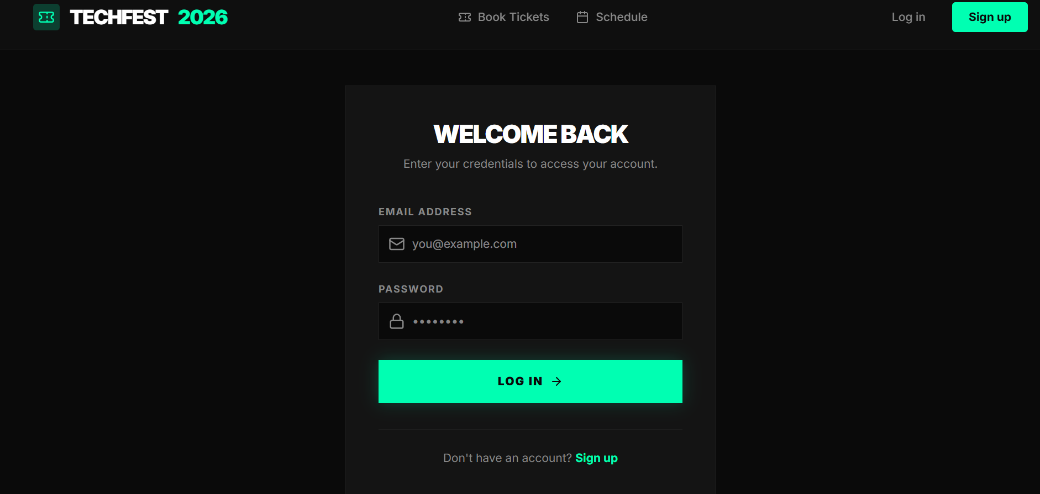
IMPLEMENTATION SCREENSHOTS
Admin Login Page
User Login Page
1
2
3
4
5
6
7
8(B)
9
Admin login page that allows administrators to securely access the system using email and password credentials.
User login page that enables registered users to sign in and access event booking features.

Slide 12
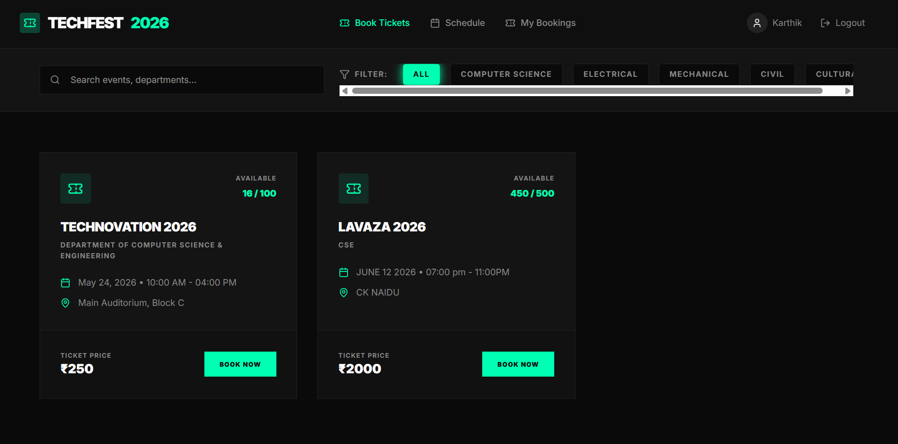
IMPLEMENTATION SCREENSHOTS
Module 1 Screenshot
Explain in 1–2 lines.
1
2
3
4
5
6
7
8(C)
9
This page shows the user dashboard after login, where users can browse events, apply filters, and search for specific college events easily.
It also provides options like book tickets, view schedules, and check bookings, along with event details, availability, and pricing.

Slide 13
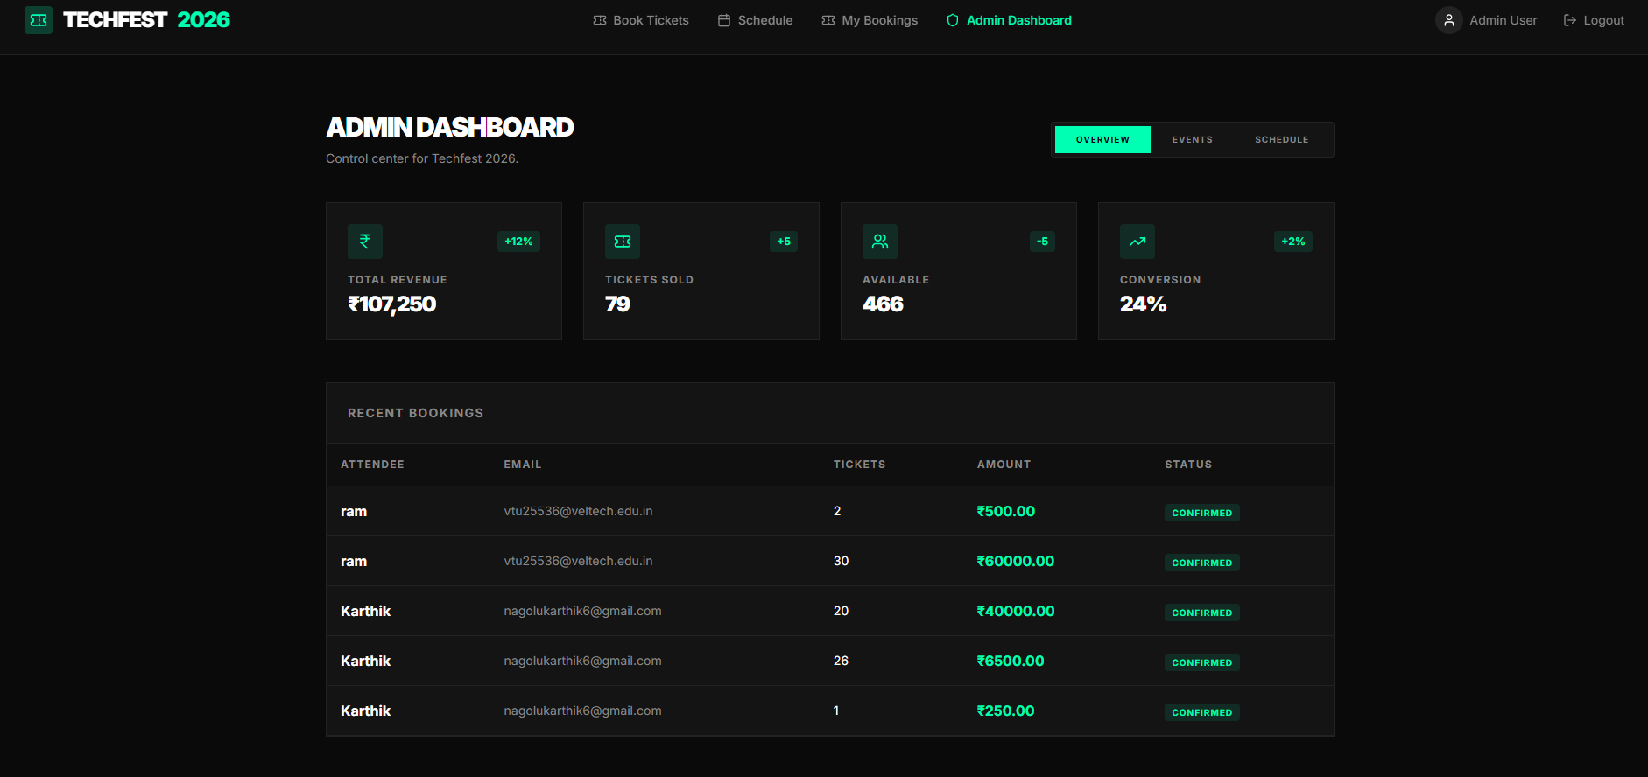
IMPLEMENTATION SCREENSHOTS
1
2
3
4
5
6
7
8(C)
9
This page shows the Admin Dashboard, providing an overview of key metrics such as total revenue, tickets sold, availability, and conversion rate.
It also displays recent bookings with user details, ticket count, payment amount, and status, helping admins monitor and manage events efficiently.

Slide 14
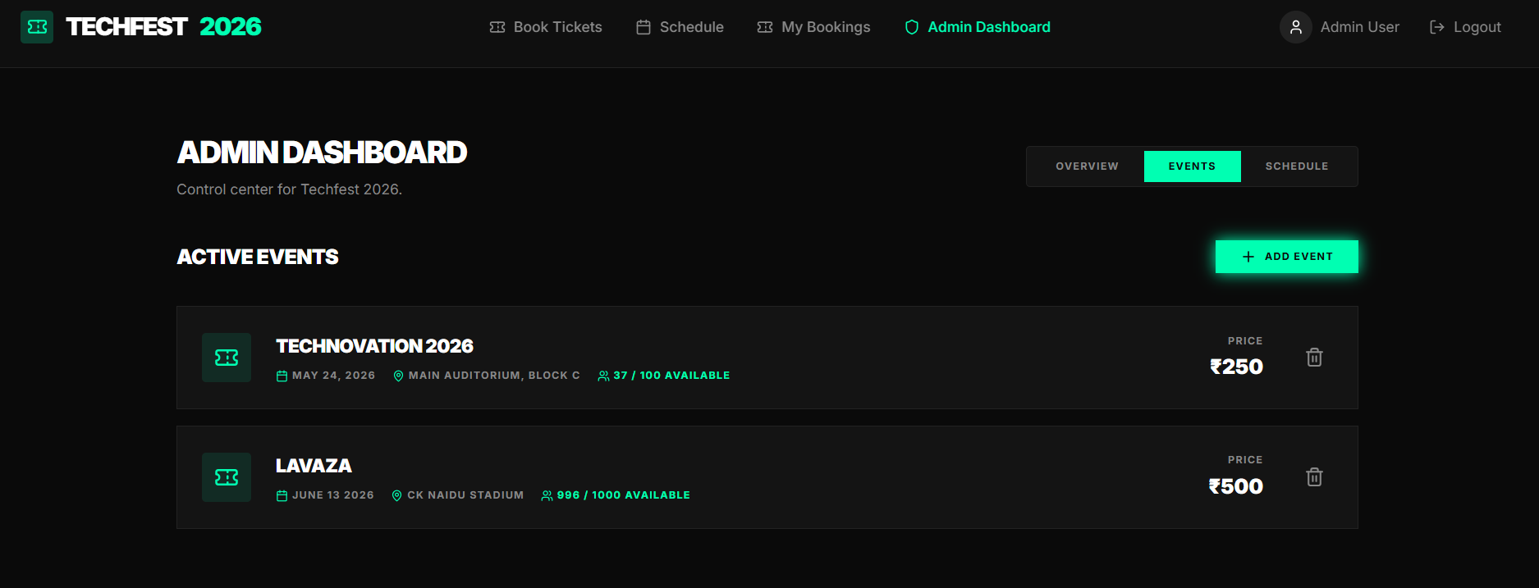
IMPLEMENTATION SCREENSHOTS
1
2
3
4
5
6
7
8(C)
9
This page displays the Admin Events Management section, where admins can view all active events with details like date, venue, availability, and price.
It also provides options to add new events and manage existing ones, enabling efficient control over event listings.

Slide 15
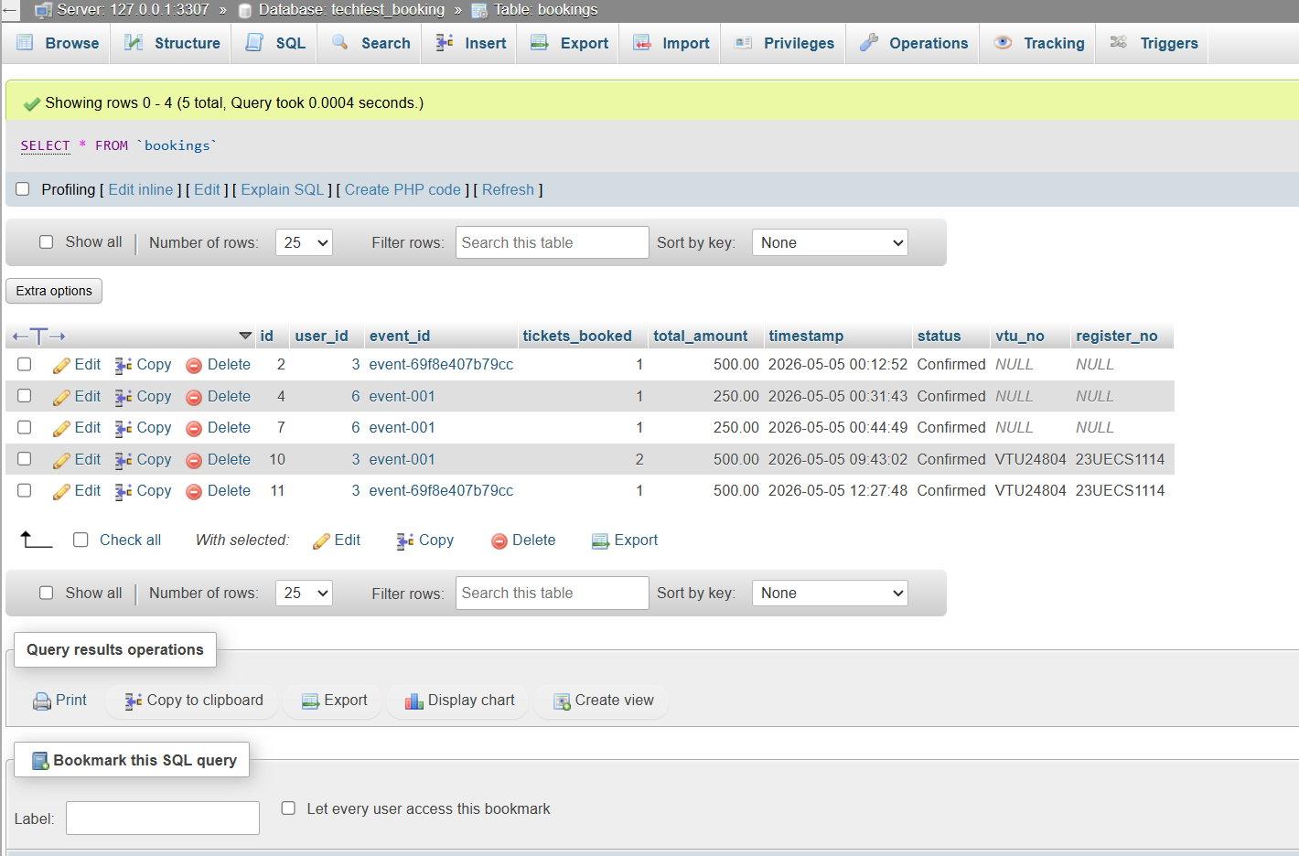
IMPLEMENTATION SCREENSHOTS
1
2
3
4
5
6
7
8(C)
9
This image shows the database table (bookings) in phpMyAdmin, displaying stored booking records with fields like user ID, event ID, tickets booked, and payment details.
It provides options to view, edit, delete, and manage booking data, ensuring efficient backend data handling.

Slide 16
ADVANTAGES & LIMITATIONS
> ADVANTAGES
- Reduces manual work and paperwork
- Saves time with quick online booking
- Minimizes errors in ticket management
- Provides real-time updates on availability
- Easy access from anywhere (web-based)
- Secure and organized data handling
- Improves user experience and convenience
> LIMITATIONS
- Requires stable internet connection
- Depends on system/server availability
- Initial setup and maintenance cost
- Risk of technical issues or bugs
- Users need basic digital knowledge
- Payment failures may affect booking process
1
2
3
4
5
6
7
8
9

Slide 17
Thank you

